Slide 1
National institute of technology Calicut NITC PLACEMENT WEBSITE Guided by : Dr . GOPAKUMAR G
Prepared by :Rajkumar Rajput
M210666CA

Slide 2
Content :
About existing system.
Introduction
Key features.
Use case Diagram
ER Diagram.
Technology Stack
Users.
Admin

Slide 3
About Existing System
Student can’t see the previous placement records remotely.
Student can’t view their interview schedules they have to be notified by PRs.
Students cannot view the visiting companies they have to get this information through CCD.

Slide 4
Introduction
The "NITC PLACEMENT WEBSITE SYSTEM" was created to fix the problems we had with the old manual system. Before, students had to rely on placement representatives for any information they needed. Plus, applying for a job was only possible through the Genskill application, and students had to depend on placement representatives for further processing.

Slide 5
Why NITC PLACEMENT WEBSITE
User-Friendly Interface: NITC placement website has a user-friendly interface, making it easy for students to navigate and access essential information regarding placements.
Comprehensive Information: The website provides comprehensive information about placement opportunities, including details about participating companies, job profiles, eligibility criteria, and recruitment processes.
Placement Statistics: Emphasize the availability of placement statistics on the website, showcasing the success rate of previous placement seasons, average salary packages, and companies visiting the campus.

Slide 6
Key Features:
Real-Time Updates: Stay updated with real-time notifications about upcoming placement drives, internship opportunities, and industry trends, ensuring students are always in the loop.
Transparent Placement Statistics: Gain insights into past placement statistics, including average salary packages, placement rates, and top recruiting companies, empowering students to make informed career decisions.
User-Friendly Interface: The NITC placement website boasts a user-friendly interface, making it effortless for students to navigate and explore various career opportunities..

Slide 7
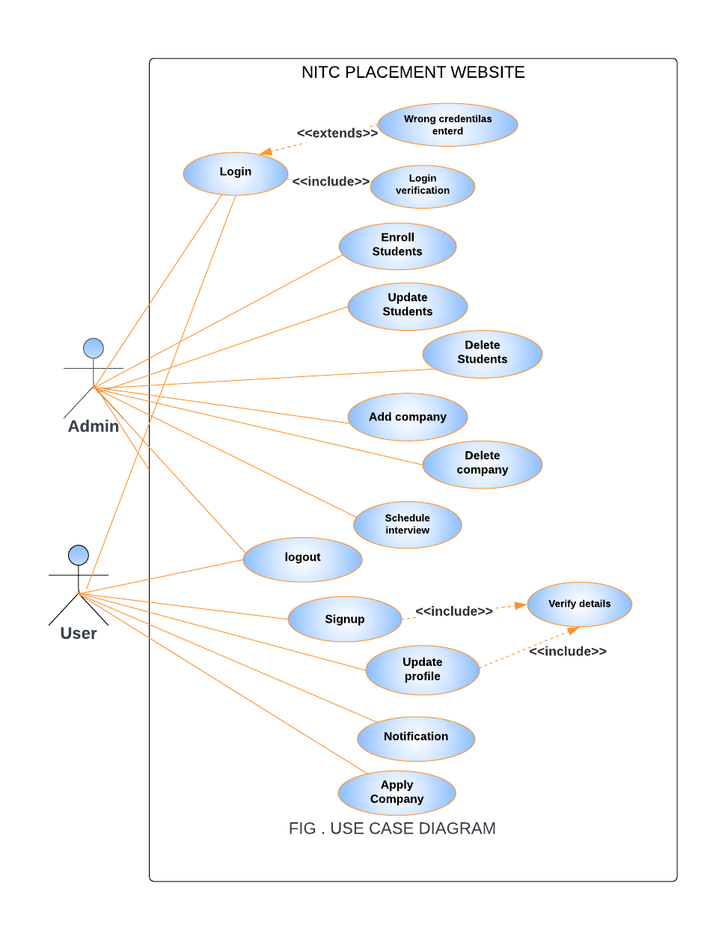
USE CASE DIAGRAM

Slide 8
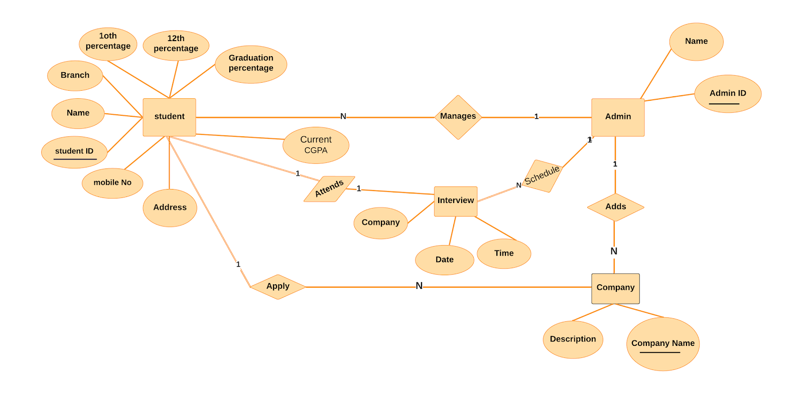
ER DIAGRAM

Slide 9
Technology stack
React 18.
Express 4.18.2
Nodejs 20.11.1.
MongoDB 7.0.
JavaScript ES 6.
Html 5.
Bootstrap CSS V5.3.3

Slide 10
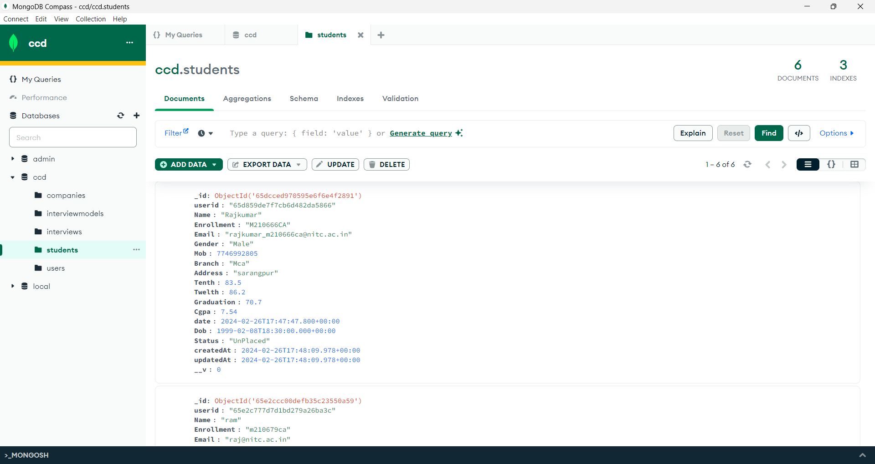
NOSql Database MongoDb

Slide 11
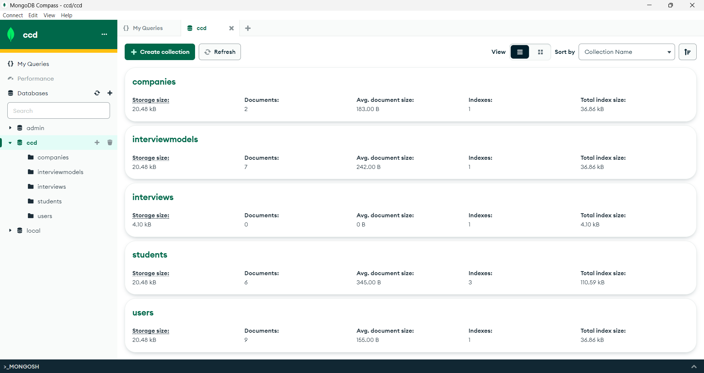
NOSql Database MongoDb

Slide 12
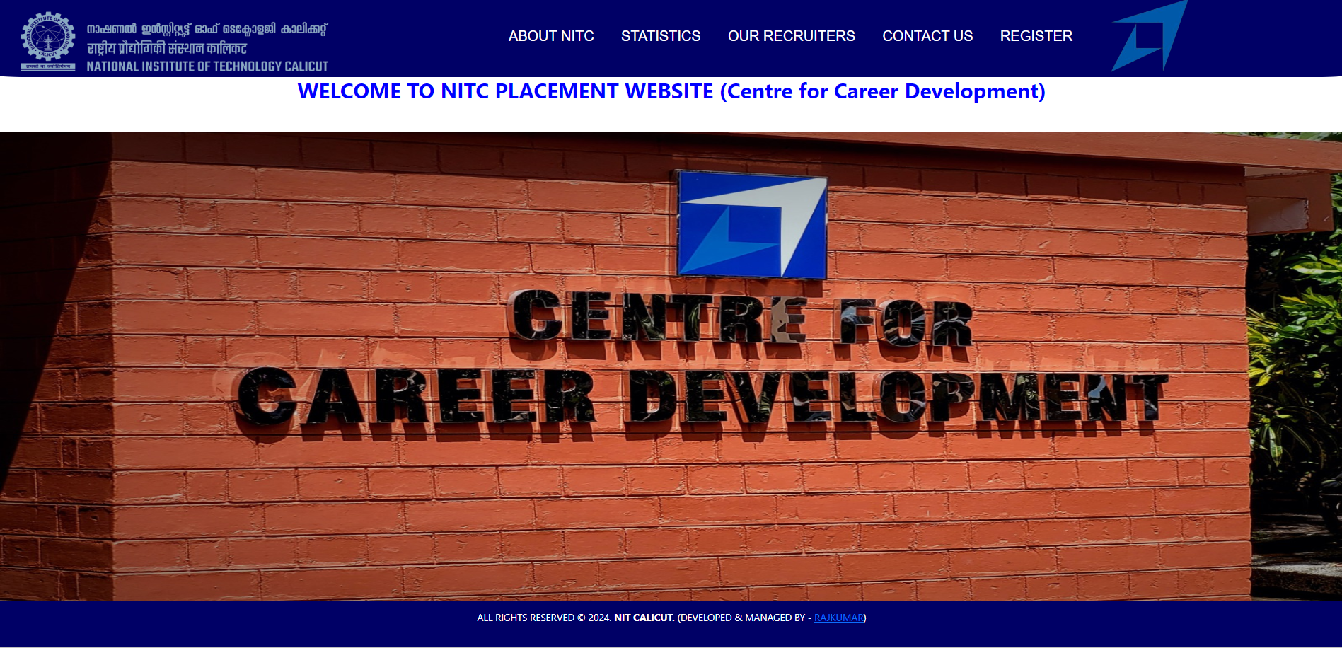
Home page

Slide 13
User can see following features without login in website
About Placement Website
Our Recruiters.
Previous Year Placement Statistics ( including number of students placed According to Branch in different Years).
Contact Us

Slide 14
Product Features
User Features
User can register/login themselves.
User can view About placement Website.
User can View Placement Statistics of previous year.
User can Contact Admin by filling Respective Form.
User can Apply company if user eligible for particular company.
User can see Company Interview Notification if he/she having interview,

Slide 15
Admin Features
Actions exclusive to Admin are :-
Admin can Login and update profile.
Admin can Enrol Students for Upcoming Placement Drives.
Admin can Update and Delete students profiles.
Admin can View current year placement statistics for every Branch.
Admin can View Students according to placed /unplaced, Branch, Enrolment date.
Admin can add / remove Companies for Upcoming Placement Drives.
Admin can schedule Students interviews.

Slide 16
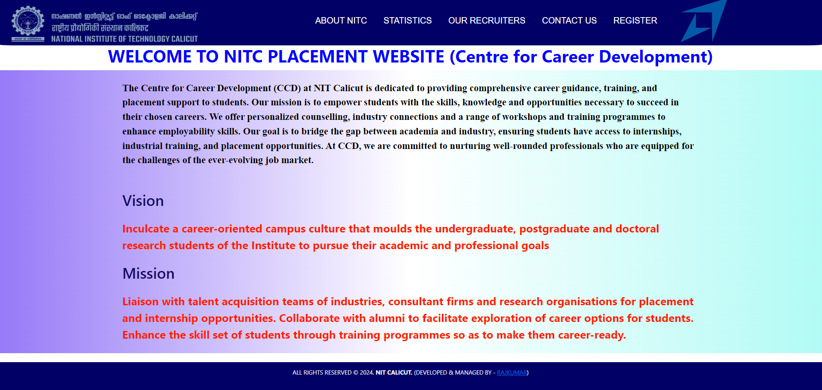
About NITC
This interface is About NITC Placementcell mission and Vision

Slide 17
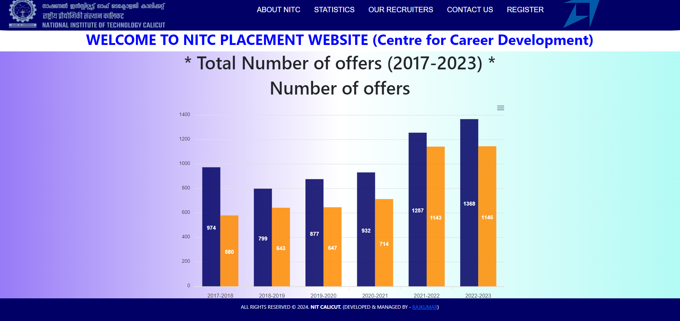
Placement Statistics
Total Number of Placements

Slide 18
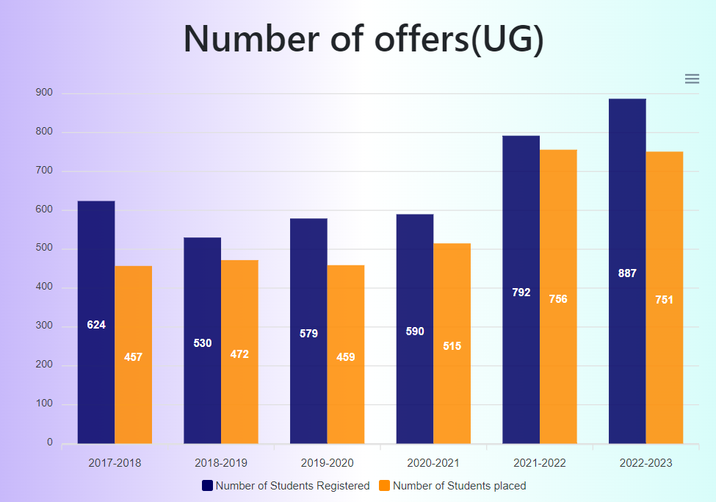
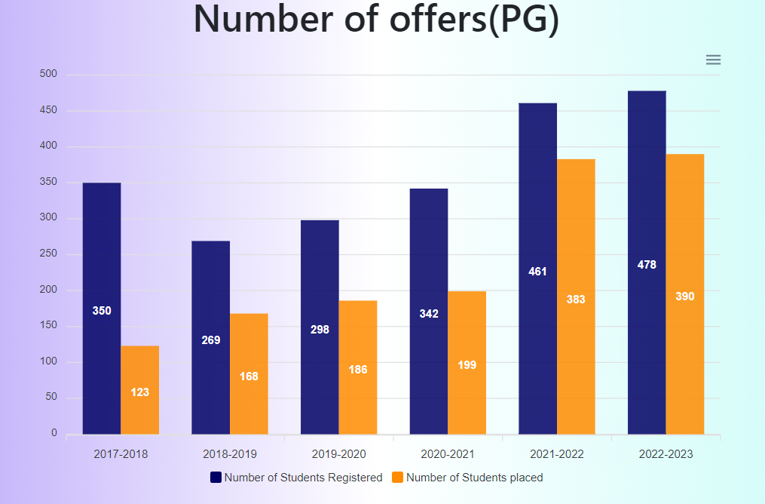
Placement Statistics

Slide 19
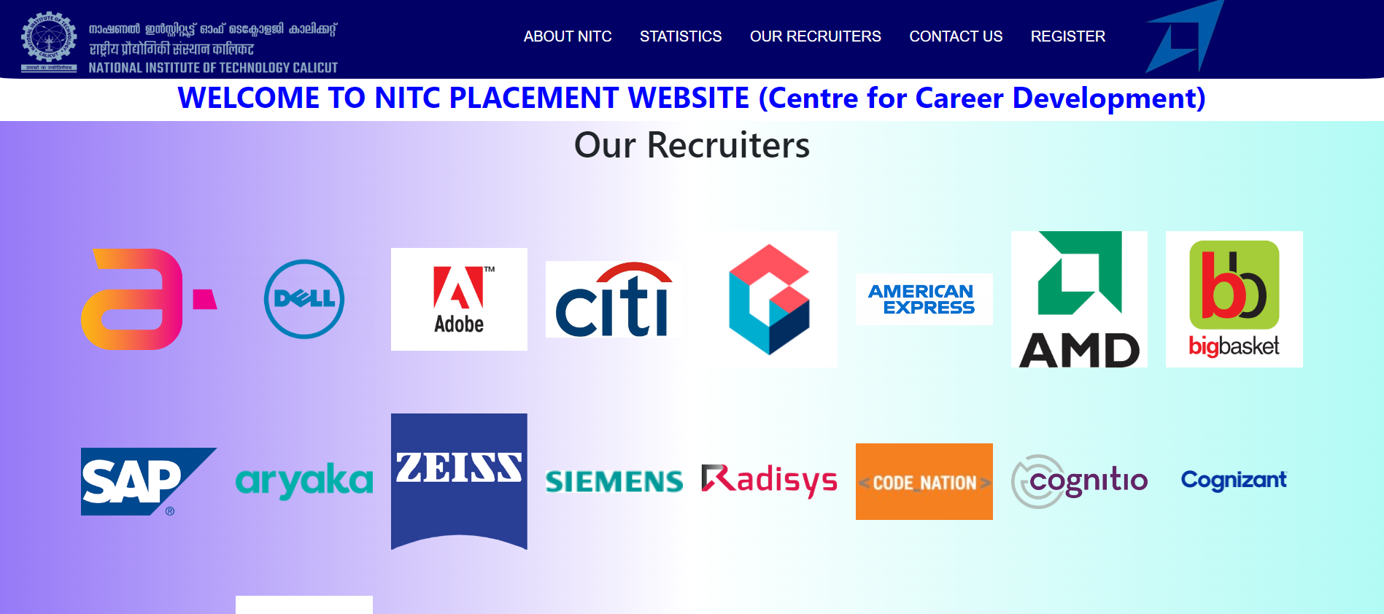

Recruiters

Slide 20
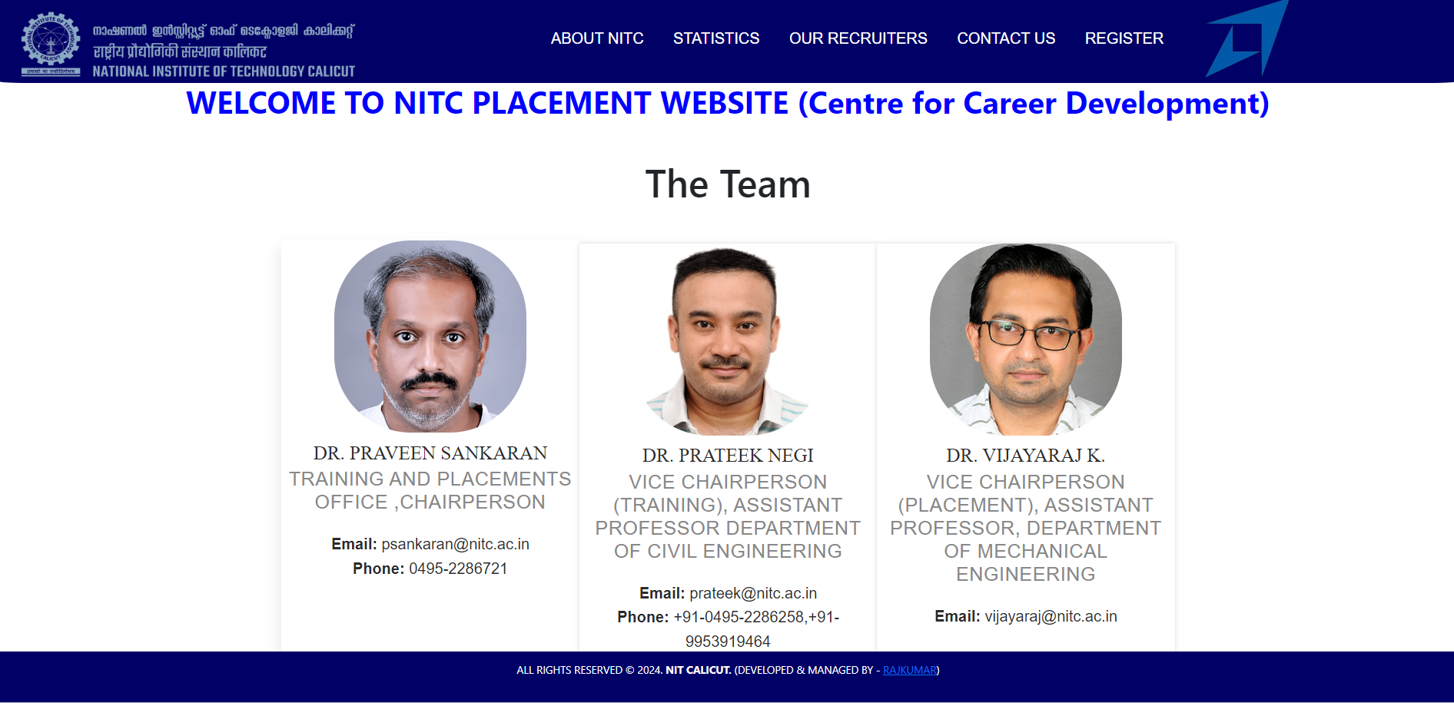
Placement Team

Slide 21
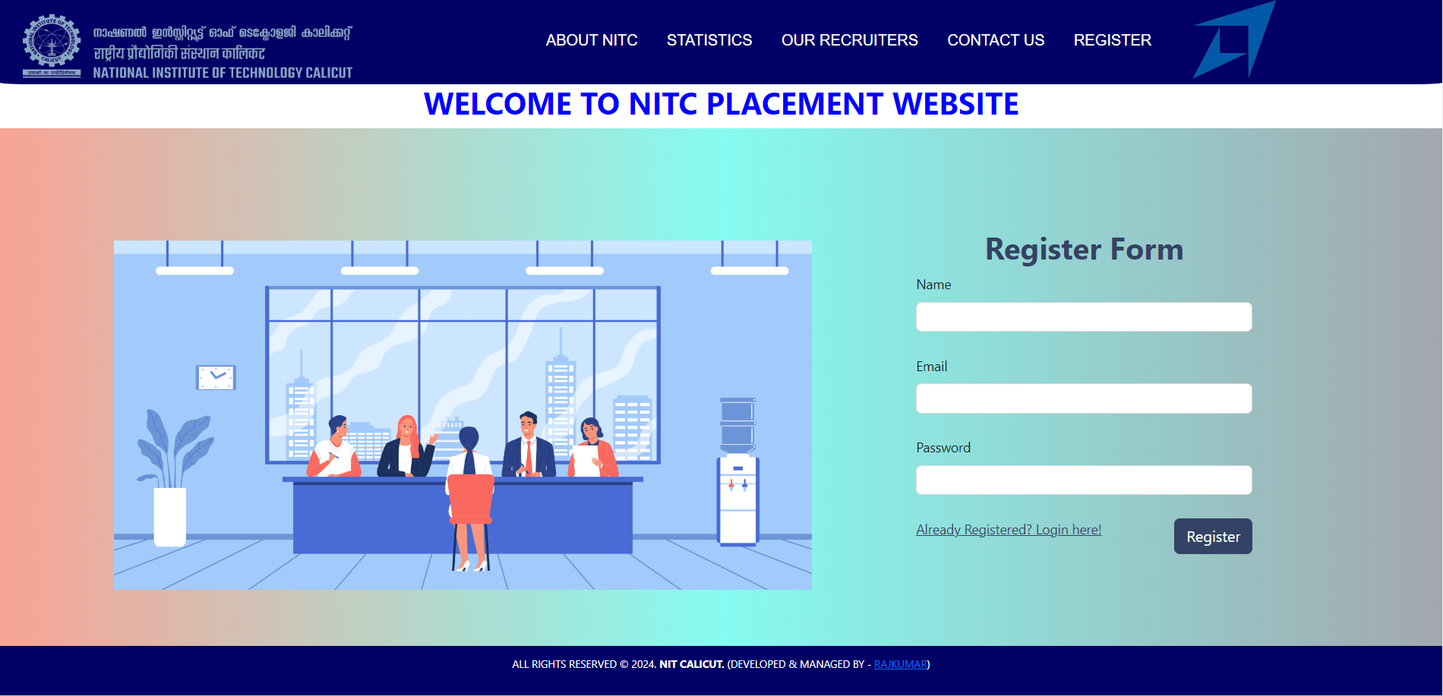
User can register.

Slide 22
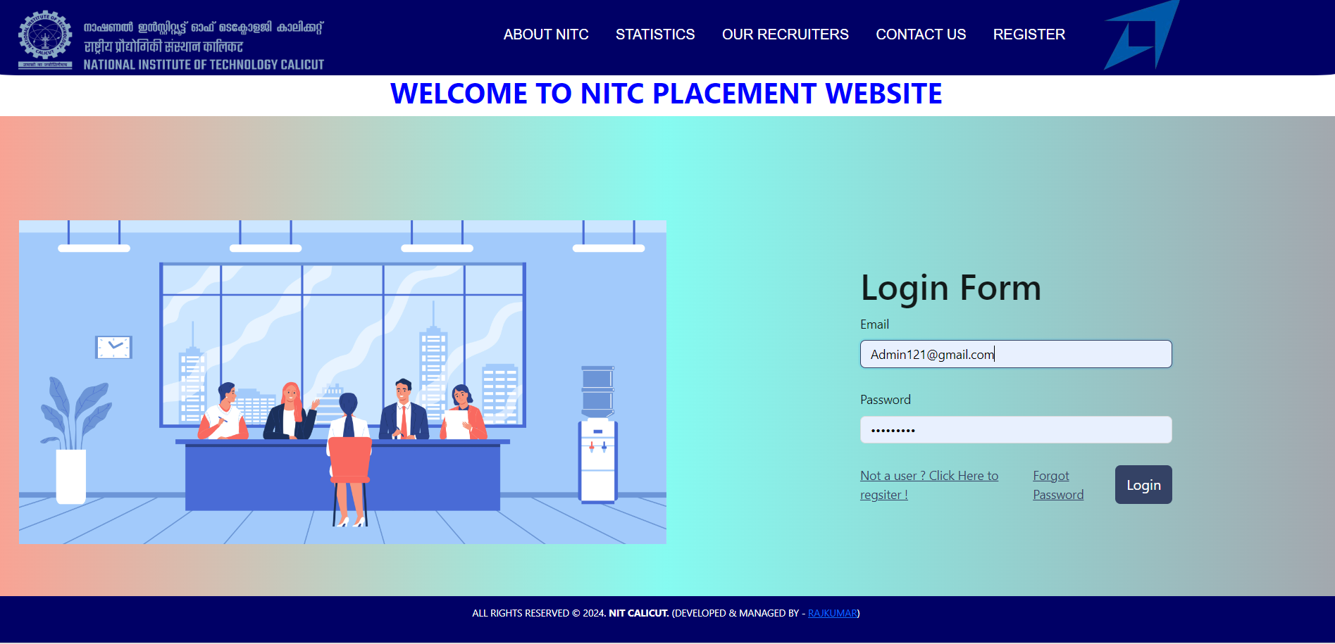
Admin login.
“Admin” can also login in the system by providing the username and password set in database later admin can also edit their profile multiple admin can also be allowed.

Slide 23
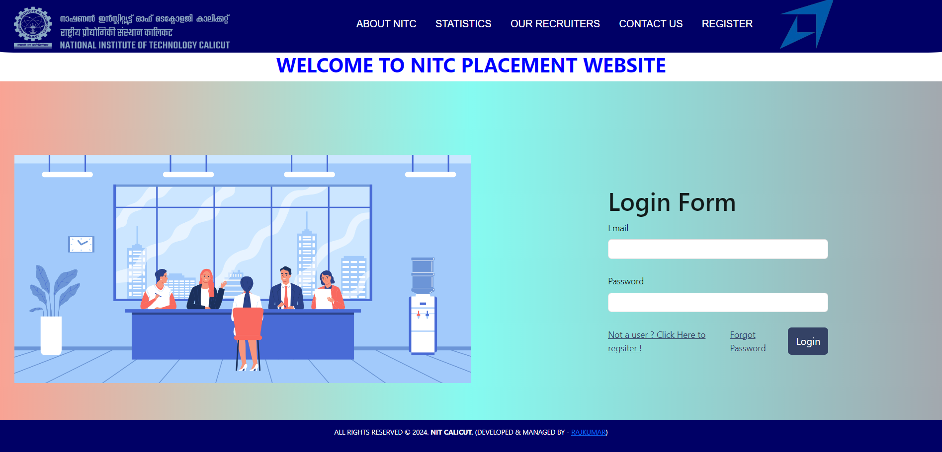
User can login/register(cont.).
This interface is of Login where users can login themselves by providing details such as required details.

Slide 24
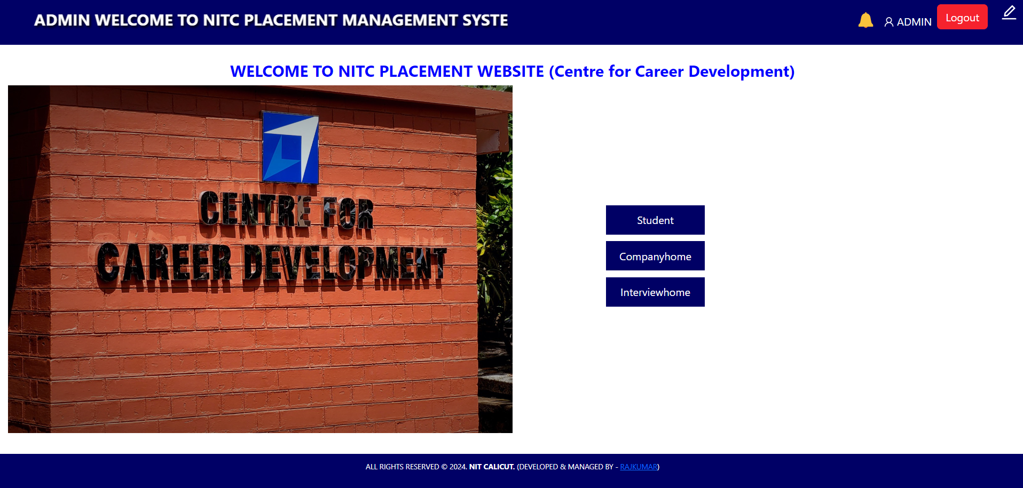
Admin page

Slide 25
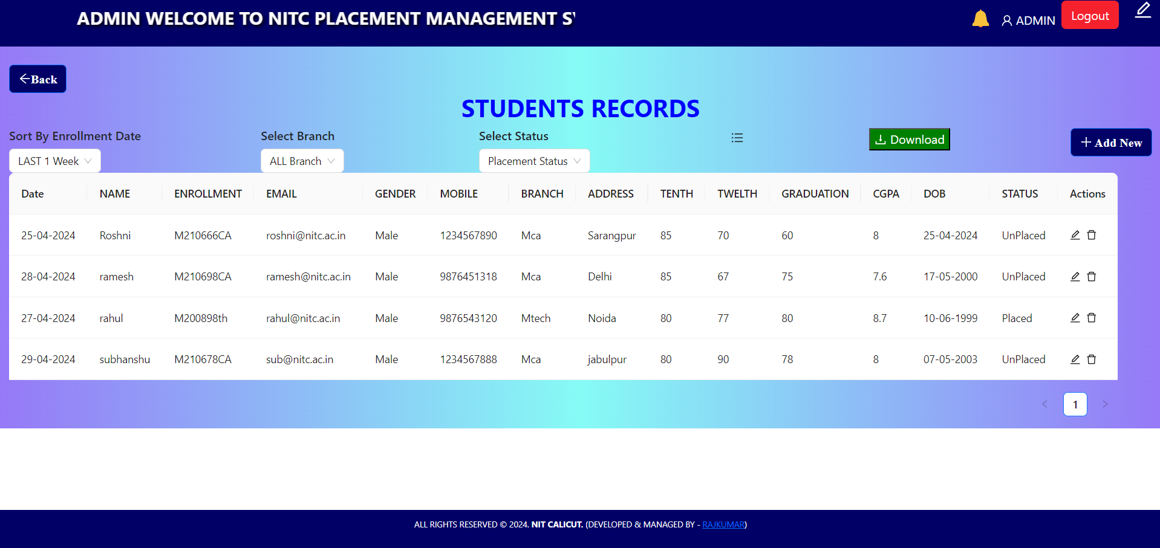
Admin Can Enrol Students
This website basically design for Admin
Admin can Enrol students for upcoming placement drives by providing necessary Details.
After successfully enrolment user can see a notification their dashboard you are successfully registered for upcoming placement drives.

Slide 26
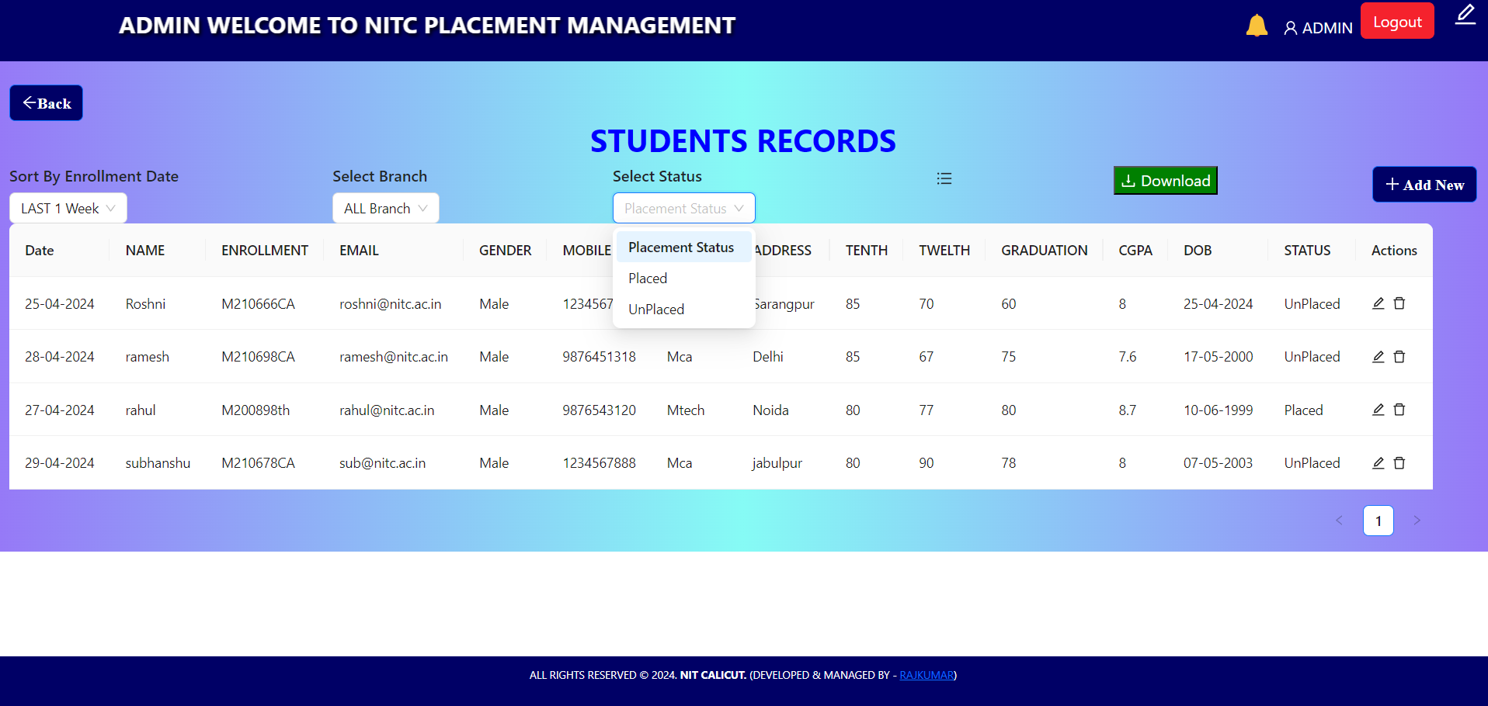
Admin can have report generated for all the students registered in placement drives.

Slide 27
Admin Can Delete and Edit Students enrolments
Admin can delete and edit Enrolments of a student for upcoming placement drives .(if found suspicious activity)
After successfully deletion of enrolments, user can see a notification on their dashboard for their enrolments deleted.

Slide 28
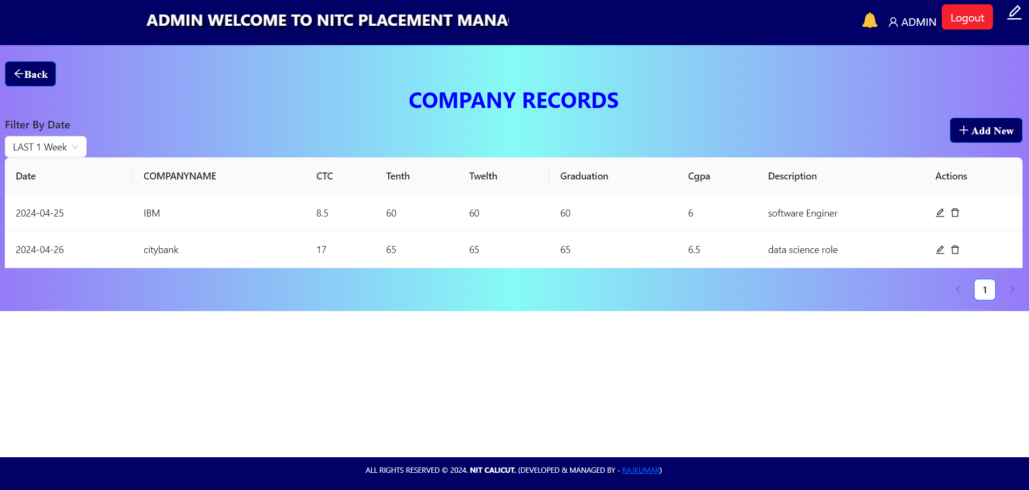
Admin can Add a Company
Admin can add a new company by inputting essential details such as Company Name, offered CTC (Cost To Company), and a brief Description of the company.

Slide 29
Delete / Edit / Search a Company
Admin can delete, edit company also admin can filter company according to the date.

Slide 30
Admin can Schedule interview
Admin can schedule interviews for students by entering Students Name, Email, Company Name, along with start and end times of the interview session.
Once the admin schedule students interview students see a notification related to interview

Slide 31
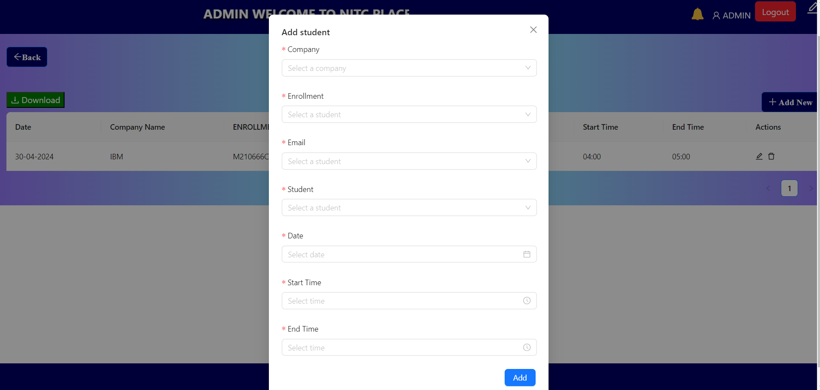
Admin can Schedule interview

Slide 32
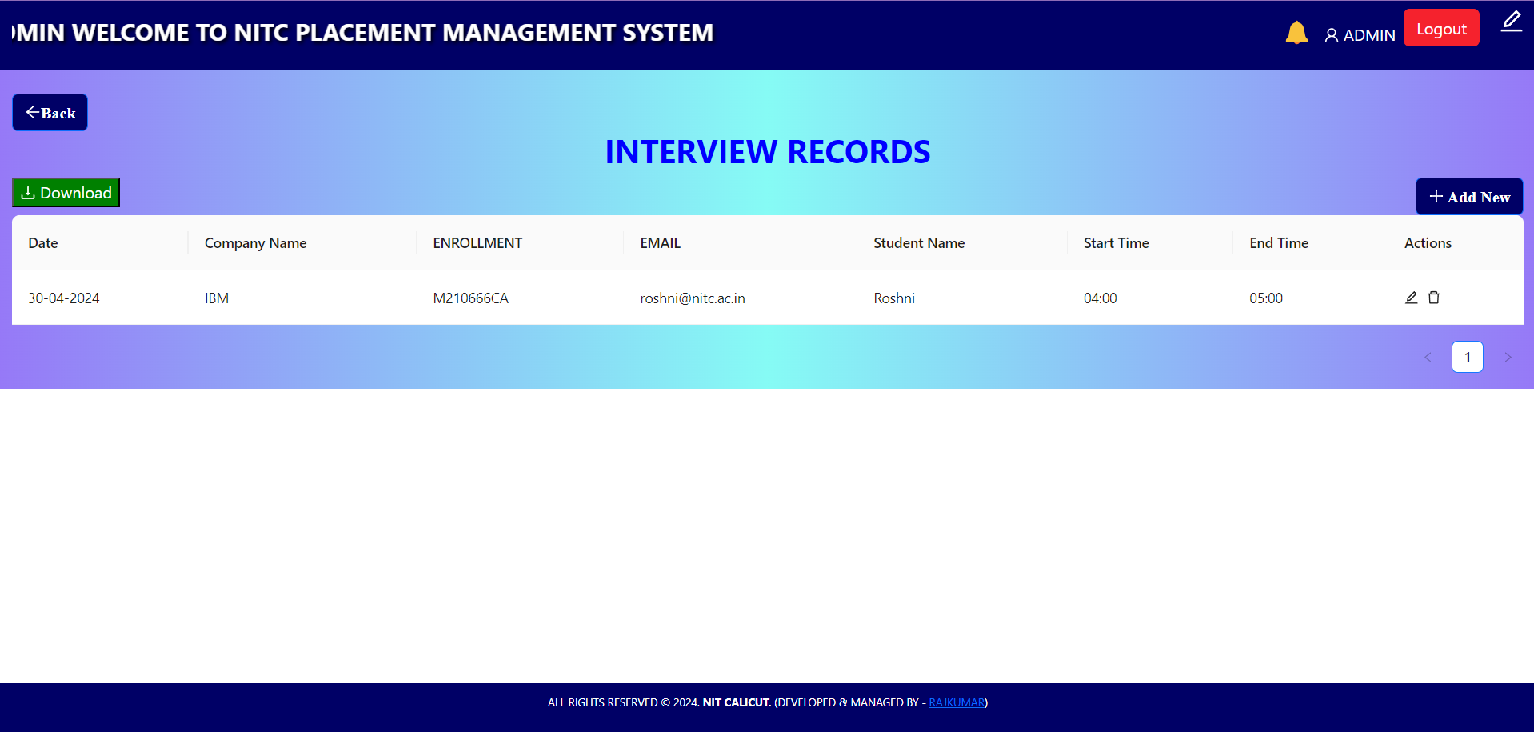
Admin can edit and delete and generate report Students interviews.

Slide 33
Admin can edit and delete and generate report Students interviews.

Slide 34
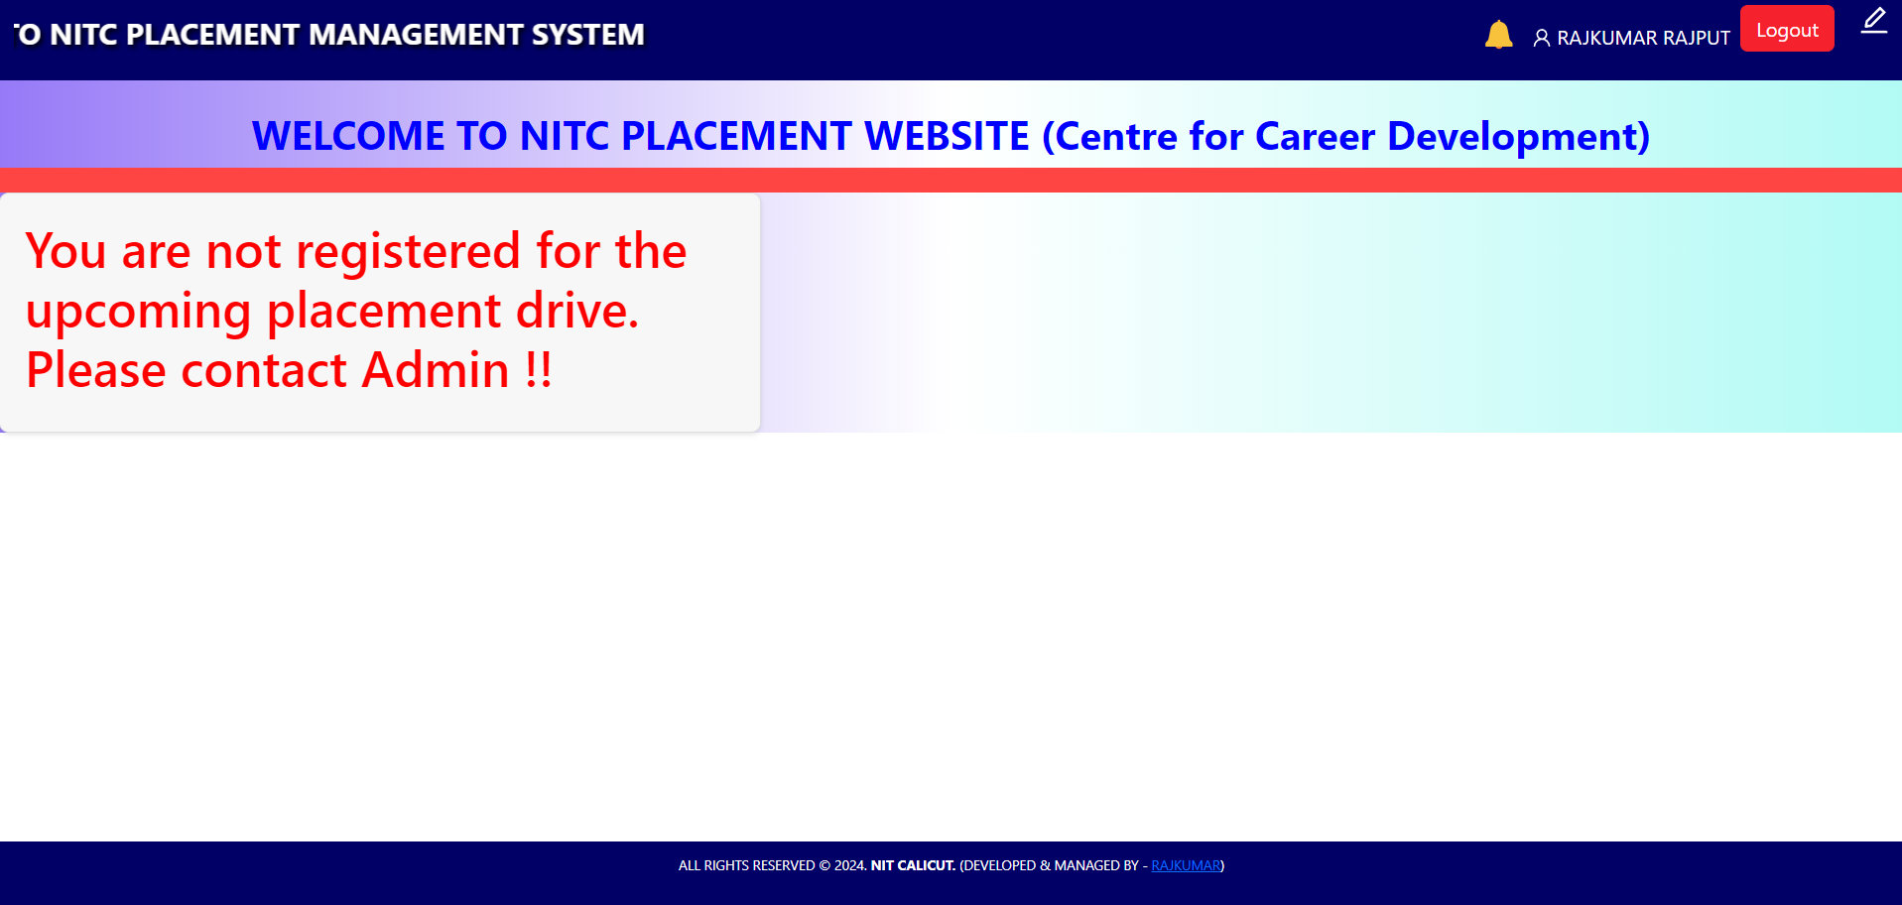
Until Admin not added User for Upcoming Placement Drive

Slide 35
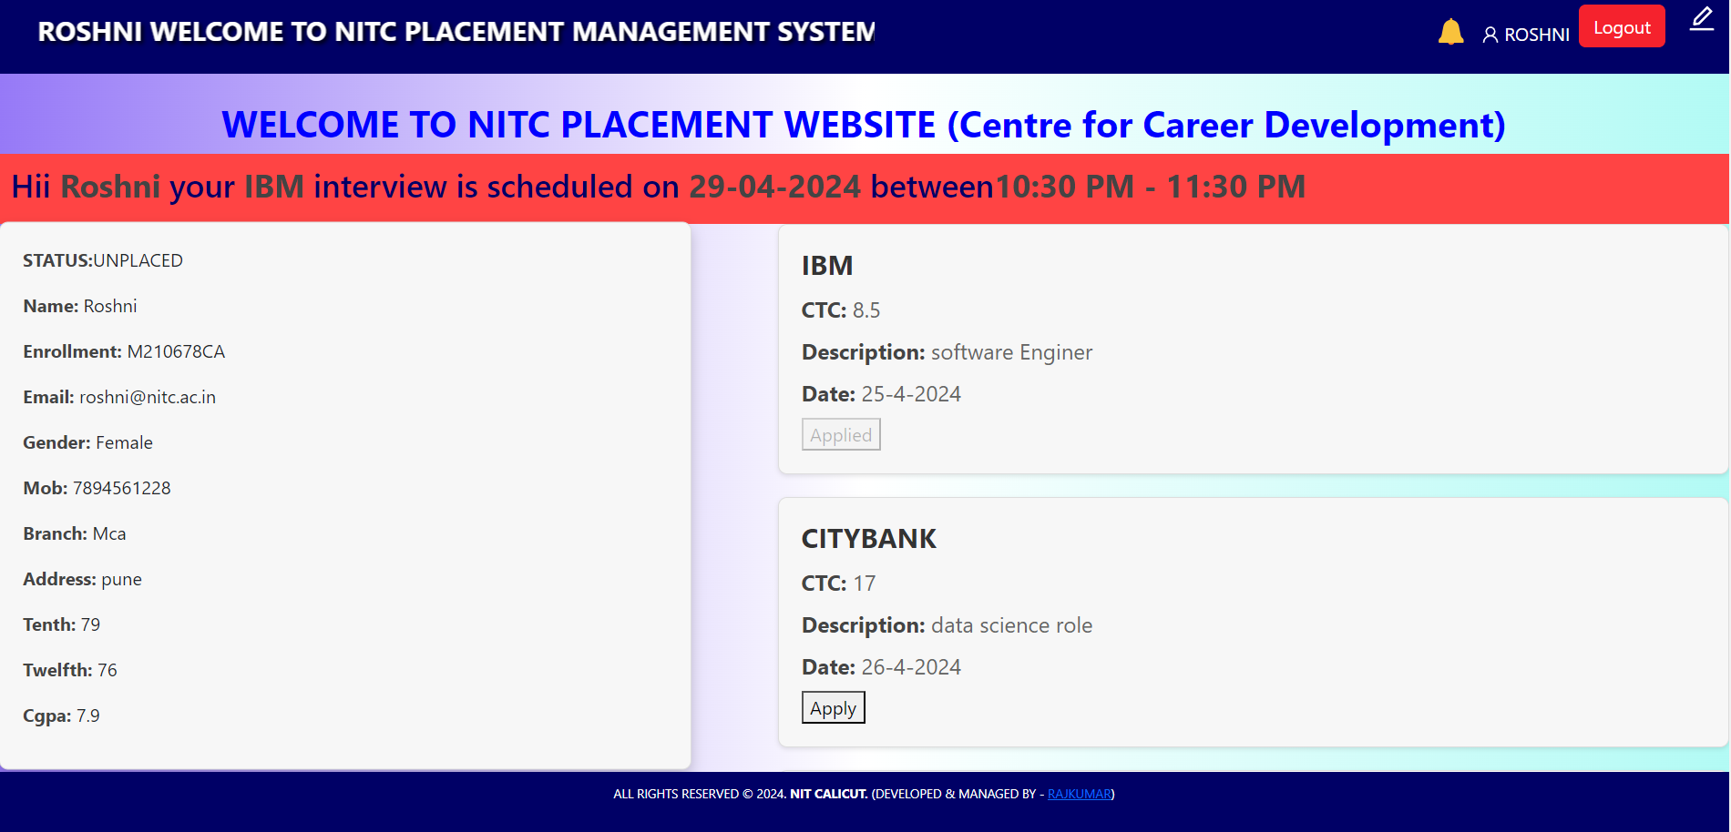
When Admin add User for Upcoming Placement Drive
User are able to see company Notification if user is eligible for Comapany

Slide 36
When Admin add User for Upcoming Placement Drive
User are able to see he/she Detilas and if user is selected for interview he/she are able to see notification for interview real time.

Slide 37
References
HTML –http://www.w3schools.com/html/ (13may2024)
Node JS - https://nodejs.org/en/docs/(10may2024)
CSS - https://developer.mozilla.org/en-US/docs/Web/CSS(10may2024)
Express JS - https://expressjs.com/en/5x/api.html(13may2024)
Javascript - https://developer.mozilla.org/en-US/docs/Web/JavaScript(13may2024)
NPM - https://docs.npmjs.com/(13may2024)
MongoDb -https://www.mongodb.com/(13may2024)
React js-https://legacy.reactjs.org/docs/getting-started.html(13may2024)

Slide 38
Thank you

